Slide 1

Computer Engineering Department
A.P. Shah Institute of Technology
G.B.Road,Kasarvadavli, Thane(W), Mumbai-400615
UNIVERSITY OF MUMBAI
Academic Year 2020-2021

Slide 2
A Project Report on
Grocery Recommendation System Submitted in partial fulfillment of the degree of
Bachelor of Engineering(Sem-7)
in
Computer Engineering
By
Asmita Shelke (17102005)
Gaurav Samant (17102050)
Chirag Sable (17102019)
Under the Guidance of
Rahul Ambekar

Slide 3
1.Project Conception and Initiation

Slide 4
1.1 Abstract
In this project we are planning to make a web application which will include a search engine like structure. In this search engine you can search for any particular product
This system will make it easier for us to locate the same item available at a cheaper price at our nearest stores.
Using recommendation system which will be implemented based on Market Basket Analysis Algorithm, will help recommend the customers about other similar products which are of better quality, healthier options for food products or cheaper alternatives.
This system will help customers to get good deals on products and also not compromise on the product they are looking for.

Slide 5
1.2 Objectives
Making ordering groceries easy and convenient.
No need to compromise on brand user prefers for any product.
Recommending user, related items to the ones purchased by user.
Recommending user healthier alternatives for selected products.

Slide 6
1.3 Literature Review
Full stack web development – Development of both client and server software using front end HTML, CSS, JQuery and backend using SQL Database
Recommendation system – We plan to build a recommendation system for the grocery application using collaborative filtering. Collaborative Filtering is the most common technique used when it comes to building intelligent recommender systems that can learn to give better recommendations as more information about users is collected.
Dataset- To experiment with recommendation algorithms, you’ll need data that contains a set of items and a set of users who have reacted to some of the items. While working with such data, you’ll mostly see it in the form of a matrix consisting of the reactions given by a set of users to some items from a set of items.

Slide 7
1.4 Problem Definition
Online grocery shopping becomes more and more popular in recent years. To facilitate the purchase process, many online stores provide a shopping recommendation system for their consumers. So far, the generic recommendation systems mainly consider preferences of a consumer based on his/her purchase histories. Here we focus on providing the above including recommendation system which compare the same products, but from different shops in the vicinity

Slide 8
1.5 Scope
This project is a web application, but it can be modified to be a android application which will make the process of ordering groceries easier.
Moreover, better models of recommendation can be implemented which can improve the accuracy and provide relevant recommendation to the users.
The application can be developed in a way where the user can subscribe to certain products, and these products will be added to the cart on a monthly or quarterly basis automatically.

Slide 9






1.6 Technology stack

Slide 10
1.7 Benefits for environment & Society
This project will make ordering groceries easy especially during pandemic times and also will help for elders who cannot step out frequently.
This project will also make sure you do not compromise on the brand you prefer.

Slide 11
2. Project Design

Slide 12
2.1 Proposed System
This project will be a web application-based project. It will have a search engine-based feature in which if you search for a particular product, you will get the options of that product available in different stores around your locality. A recommendation system will be introduced, which will recommend the customers about other better quality products, healthier or cheaper.

Slide 13
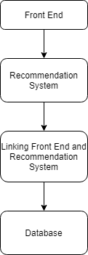
2.2 Design(Flow Of Modules)

Slide 14
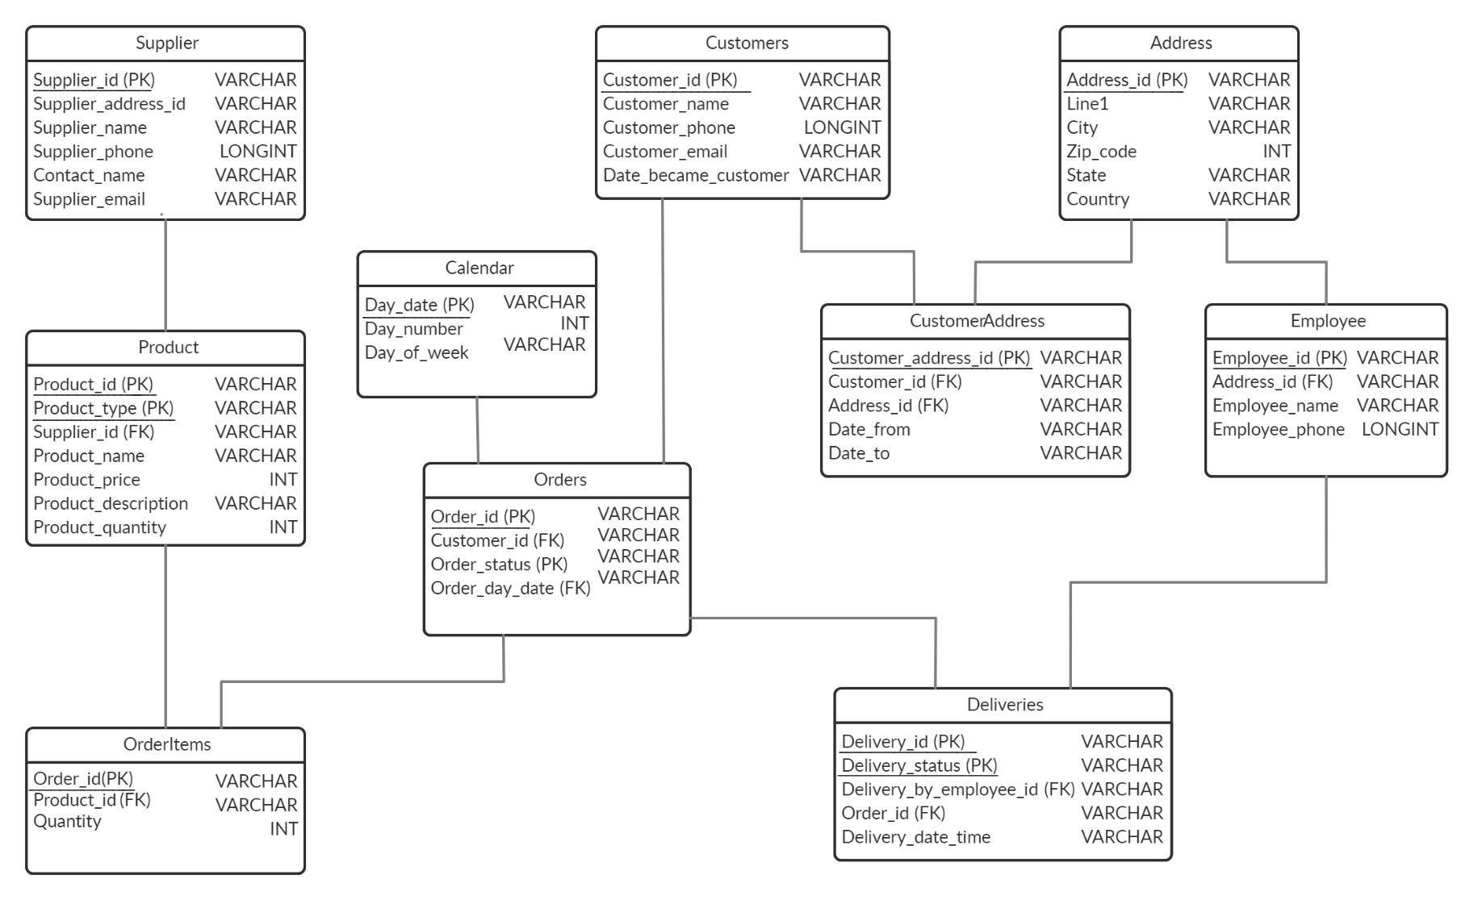
2.3 Class Diagram

Slide 15
2.4 Module-1 (FRONT END)
Module 1 – Front End
This module contains all the visual representation of the website. MS Visual Studio will be used to build it.
Front End will be developed by using technologies like HTML, CSS, Jquery and JavaScript.
Front End will be linked with the database and recommendation system.

Slide 16
Module-2 (Recommendation System)
Module 2 – Recommendation System
This module will uphold the recommendations given to the user based on his purchases and interests. Accordingly, the products will be shown.
We plan to implement recommendation system by using various models and compare the accuracy.
The model with highest accuracy will be implemented.

Slide 17
Module-3 (Back end)
Module 3 – Database System
This module will have the all the information which is entered by the user while interacting with the website.
It will also store the user’s account information.
The database system will hold all the product details and quantity which will be updated based on the users purchase.

Slide 18
2.5 References
1. https://scihub.wikicn.top/10.1109/HICSS.2016.450
Why Consumers Go to Online Grocery: Comparing Vegetables with Grains
2. https://www.researchgate.net/publication/221653590 Grocery shopping recommendations based on basket-sensitive random walk
Grocery Shopping Recommendations Based on Basket-Sensitive Random Walk
3. https://sci-hub.se/https://ieeexplore.ieee.org/document/8646645
Recommender Systems Challenges and Solutions Survey
4. Wu, Z., Zheng, J., Wang, S., & Feng, H. (2013). A Combined Predictor for Item-Based Collaborative Filtering. https://ieeexplore.ieee.org/document/6630420

Slide 19
3.Planning for next semester

Slide 20
Planning
As we have completed the designing of all the required modules and implemented the database module, we intend to further complete the recommendation system module and website (frontend-backend development) module thereby integrating these modules and thus, verifying the working of our overall project and finally complete our proposed system by meeting all the requirements, modules and functionalities as proposed by us in our report.

Slide 21
Thank You

